Slide 1
Hidden Surface Removal
Prepared By
Rutuja A Kulkarni
PICT, Pune
Reference Book : Hearn, Baker - Computer Graphics - C Version 2nd Edition

Slide 2
Introduction
A major consideration in the generation of realistic graphics displays is identifying those parts of a scene that are visible from a chosen viewing position.
There are many approaches we can take to solve this problem, and numerous algorithms have been devised for efficient identification of visible objects for different types of applications.

Slide 3
Introduction
The various algorithms are referred to as visible-surface detection methods. Sometimes these methods are also referred to as hidden-surface elimination methods.

Slide 4
CLASSIFICATION OF VISIBLE-SURFACE DETECTION ALGORITHMS
Visible-surface detection algorithms are broadly classified according to whether they deal with object definitions directly or with their projected images.
These two approaches are called object-space methods and image-space methods, respectively.

Slide 5
Object space methods
It’s a world coordinate system where space is infinite in all three directions.
Always specify viewing
Transformation either in
Perspective view or parallel view.
Hidden space removal for all object viewed in finite space( refer fig. on next page)

Slide 7
Cont’d
Transform everything on projecting plane
2D clipping is performed.
An object-space method compare objects and parts of objects to each other within the scene definition to determine which surfaces, as a whole, we should label as visible.

Slide 8
Image Space methods
In an image-space algorithm, visibility is decided point by point at each pixel position on the projection plane. Most visible-surface algorithms use image-space methods, although object space methods can be used effectively to locate visible surfaces in some cases.
Objects 3D Clipping Screen Coordinates and finally Hidden Surface removal

Slide 9
Comparison
Object Space Method | Image Space Method
1. Physical/World Coordinate System | 1. Viewport/ Device Coordinate System
2. Object part comparison for visibility | 2. Point to point pixel comparison for visibility
3. Line display algorithm | 3. Line/Surface algorithm
4. Processing time more | 4. Processing time less

Slide 10
Back face detection and removal
A fast and simple object-space method for identifying the back faces of a polyhedron is based on the "inside-outside" tests.
A point (x, y, z) is "inside" a polygon surface with plane parameters A, B, C, and D if
case 1: Ax+By+Cz+D <0

Slide 11
Cont’d
After doing inside test check that point (x, y, z) is visible or not?
When an inside point is along the line of sight to the surface, the polygon must be a back face.

Slide 12
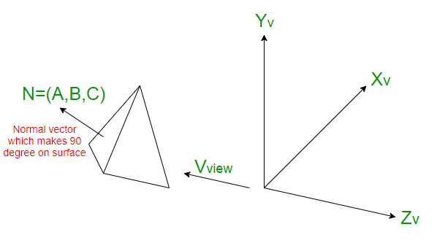
Cont’d
It applies to individual objects. It does not consider the interaction between various objects. (means overlapping objects are not considered)
Case 2: V.N>0 then it is back face surface where V is viewing direction and
N is Normal Surface vector
V.N=|V||N|cos
0<=cos <=1
or 0<= <=90 then back face

Slide 13
Cont’d
If angle between surface and viewer is 180 degrees then it’s a front surface of an object.
Case 3: N=(A,B,C) and V=(0,0,Vz) (viewing along z direction)
V.N=Vz.C
Sign of C will decide whether surface at back face or visible. If we are viewing along –ve z-direction sign(C)<0 then back face
Otherwise visible.

Slide 14
Cont’d
Disadvantages:
Doesn’t work with concave polygon properly.
It applies to individual objects

Slide 15
Depth buffer / z-Buffer
Z-buffer, which is also known as the Depth-buffer method for hidden surface detection.
It is an Image space method. It compares surface depths at each pixel position on the projection plane.
Each surface of a scene is processed separately, one point at a time across the surface.
As implied by the name of this method, two buffer areas are required. A depth buffer is used to store depth values for each (x, y) position as surfaces are processed, and the refresh buffer stores the intensity values for each position.

Slide 16
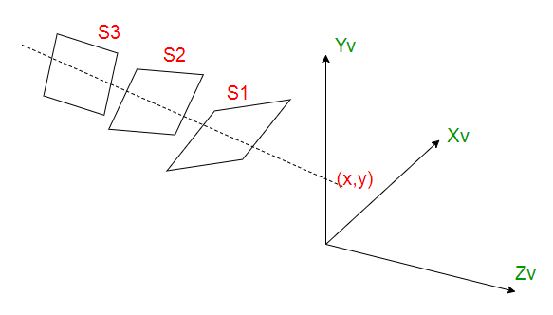

Slide 17
Cont’d
Let S1, S2, S3 are the surfaces. The surface closest to projection plane is called visible surface. The computer would start (arbitrarily) with surface 1 and put it’s value into the buffer. It would do the same for the next surface. It would then check each overlapping pixel and check to see which one is closer to the viewer and then display the appropriate color. As at view-plane position (x, y), surface S1 has the smallest depth from the view plane, so it is visible at that position.

Slide 18
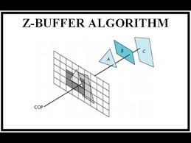

Slide 19
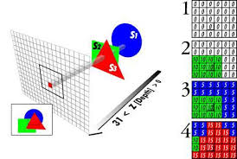

Slide 20
Cont’d
The Z-buffer method compares surface depths at each pixel position on the projection plane.
Object depth is usually measured from the view plane along the z axis of a viewing system.
Algorithm:
First of all, initialize the depth of each pixel. i.e, depth(x, y) = 0
Initialize the color value (intensity) for each pixel as refresh(x, y) = background color for each polygon,

Slide 21
Cont’d
For each position on each polygon surface, compare depth values to previously stored values in the depth buffer to determine visibility.
Calculate the depth z for each (x, y) position on the polygon.
If z > depth(x, y), then set
depth( x, y)=z refresh( x, y)=color

Slide 22

Cont’d
Depth values for a surface position (x, y) are calculated from the plane equation for each surface:
For any scan line (fig. on next page), adjacent horizontal positions across the line differ by 1, and a vertical y value on an adjacent scan line differs by 1. If the depth of position (x, y) has been determined to be z, then the depth z' of the next position (x + 1, y) along the scan line is obtained from Eq. as

Slide 23


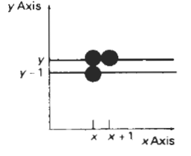
Cont’d
From position (x, y) on a scan
line, the next position across
the line has coordinates
( x + 1, y), and the position
immediately below on the
next line has coordinates
(x, y - 1).

Slide 24
Cont’d
The ratio -A/C is constant for each surface, so succeeding depth values across a scan line are obtained from preceding values with a single addition.
We first determine the y-coordinate extents of each polygon, and process the surface from the topmost scan line to the bottom scan line, Starting at a top vertex, we can recursively calculate x positions down a left edge of the polygon as x' = x - l/m, where m is the slope of the edge

Slide 25


Cont’d
Depth values down the edge are then obtained recursively as:

Slide 26
Cont’d
Advantages:
Simple to use
Can be implemented easily in image sapce and it requires no sorting of the surfaces in a scene.
Can be executed quickly, even with many polygons
Disadvantages:
Takes up a lot of memory
Can't do transparent surfaces without additional code

Slide 27
Scan-Line Algorithm
It is extension of polygon filling scan line algorithm.
The scan-line algorithm is another image-space algorithm. It processes the image one scan-line at a time rather than one pixel at a time. By using area coherence of the polygon, the processing efficiency is improved over the pixel oriented method.

Slide 28
Cont’d
Using an active edge table, the scan-line algorithm keeps track of where the projection beam is at any given time during the scan-line sweep.
When it enters the projection of a polygon, an IN flag goes on, and the beam switches from the background colour to the colour of the polygon.
After the beam leaves the polygon's edge, the colour switches back to background colour. To this point, no depth information need be calculated at all.

Slide 29
Cont’d
However, when the scan-line beam finds itself in two or more polygons, it becomes necessary to perform a z-depth sort and select the colour of the nearest polygon as the painting colour.
Scan-Line algorithm has three tables
Edge Table(ET)
Active Edge Table(AET)
Polygon Table(PT)

Slide 30
Cont’d
ET | AET | PT
x@ymin | Scan line | Polygon coefficient: (A, B, C, D) coefficients of the plane of each polygon
ymax | Edge (intersecting edges) | Shading color
x-increment (1/m) | surface | IN/OUT
pointers to the polygon table |  | Pointer to edge table

Slide 31
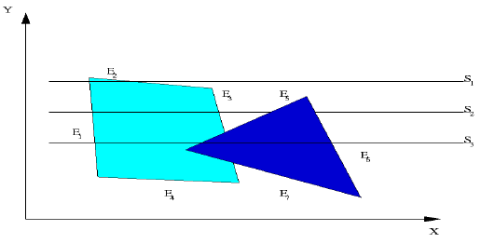
Cont’d
In the following Figure scan-line S1 must deal only with the left-hand object. S2 must plot both objects, but there is no depth conflict. S3 must resolve the relative z-depth of both objects in the region between edge E5 and E3 . The right-hand object appears closer.
Surface 1
Surface 2

Slide 32
Cont’d
AET for given figure is as below:
At edge E1 , the IN flag goes up for the left-hand polygon, and the beam switches to its colour until it crosses edge E2, at which point the IN flag goes down and the colour returns to background.
ScanLine | Edge | Surface
S1 | E1 and E2 | Surface 1
S2 | E1 , E3 , E5 , and E6 | Surface 1 & Surface 2
S3 | E1 , E5 , E3 , and E6 | Surface 1 & Surface 2

Slide 33
Cont’d
The IN flag goes up and down twice in sequence during this scan. Each time it goes up pointers identify the appropriate polygon and look up the colour to use in painting the polygon.
For scan line S3 , the active edge list contains the same edges as for S2 , but the order is altered, namely E1 , E5 , E3 , E6 . Now the question of relative z-depth first appears. The IN flag goes up once when we cross E1 and again when we cross E5 , indicating that the projector is piercing two polygons.

Slide 34
Cont’d
Now the coefficients of each plane and the (x,y) of the E5 edge are used to compute the depth of both planes. In the example shown the z-depth of the right-hand plane was smaller, indicating it is closer to the screen. Therefore the painting colour switches to the right-hand polygon colour which it keeps until edge E6 .
Note: Refer pdf of Hidden surface removal for more details

Slide 35
Painter’s Algorithm
It is also called a depth-sort algorithm.
Surfaces are sorted in increasing order of DEPTH.
Display them in back-to-front order
Resolve ambiguities when polygons overlap (in DEPTH), splitting polygons overlap (in DEPTH), splitting polygons if necessary.
Surfaces are scan converted in order Surfaces are scan converted in order, starting with the surface of greatest DEPTH. (like painter paints background first then further objects)

Slide 36
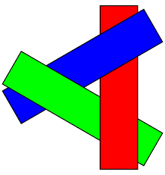
Steps to perform painting
Assuming we are viewing along the -z direction, surfaces are ordered on the first pass according to the smallest z value on each surface.
Surface S with the greatest depth is then compared to the other surfaces in the list to determine whether there are any overlaps in depth.
Fig shows Depth overlap example

Slide 37
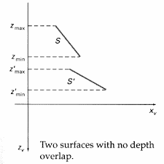
Cont’d
If no depth overlaps occur, S is scan converted. Figure shows two surfaces that overlap in the xy plane but have no depth overlap.
This process is then repeated
for the next surface in the list.
As long as no overlaps occur,
each surface is processed in
depth order until all have
been scan converted.

Slide 38
Cont’d
If a depth overlap is detected at any point in the list, we need to make some additional comparisons to determine whether any of the surfaces should be reordered.
We make the following 4 tests for each surface that overlaps with S. If any one of these tests is true, no reordering is necessary for that surface.
The tests are listed in order of increasing difficulty.
Reordering is required if all the four tests fail.

Slide 39
Cont’d
1. The bounding rectangles in the xy plane for the two surfaces do not overlap.
2. Surface S is completely behind the overlapping surface relative to the viewing position.
3. The overlapping surface is completely in front of S relative to the viewing position.
4. The projections of the two surfaces onto the view plane do not overlap.

Slide 40
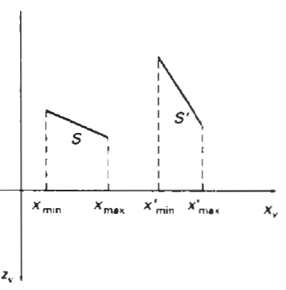
Cont’d
Test 1 is performed in two parts. We first check for overlap in the x direction, then we check for overlap in the y direction. If either of these directions show no overlap, the two planes cannot obscure one other.
Example surfaces that overlap
in the z direction but not in
the x direction is shown:

Slide 41
Cont’d
We can perform tests 2 and 3 with an "inside-outside" polygon test. That is, we substitute the coordinates for all vertices of S into the plane equation for the overlapping surface and check the sign of the result. If the plane equations are set up so that the outside of the surface is toward the viewing position, then S is behind S' if all vertices of S are "inside" S‘ (fig 1). Similarly, S' is completely in front of S if all vertices of S are "outside" of S'. Fig 2 shows an overlapping surface S' that is completely in front of S, but surface S is not completely "inside" S' (test 2 is not true).

Slide 42
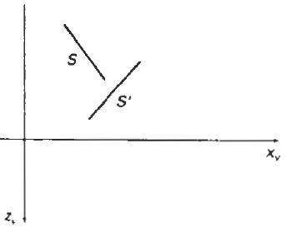
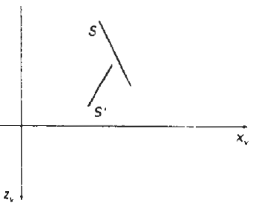
Test 2 and 3
Surface S is completely
behind ("inside") the
overlapping surface S‘.
Overlapping surface S' is
completely in front ("outside")
of surface S, but S is
not completely behind S'

Slide 43
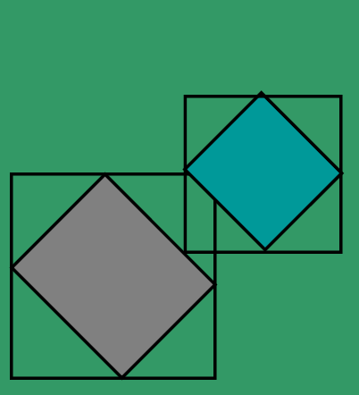
Cont’d
If tests 1 through 3 have all failed, we try test 4 by checking the projections of the two surfaces onto the view plane do not overlap.

Slide 44
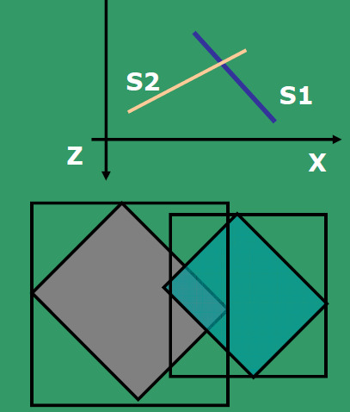
Cont’d
But if the projection overlaps.
As all 4 tests failed.
then reorder.

Slide 45
Area sub-division method
Also known as WARNOCK’s Algorithm.
Examine and divide if necessary
Works in image space
Area Coherence is exploited
Divide-and-conquer strategy.
Possible relationships of the area of interest (rectangular, AOI) and the projection of the polygon:

Slide 46
Cont’d
We apply this method by successively dividing the total viewing area into smaller and smaller rectangles until each small area is the projection of part of a single visible surface or no surface at all.

Slide 47
Cont’d
To implement this method, we need to establish tests that can quickly identify the area as part of a single surface or tell us that the area is too complex to analyse easily.
Starting with the total view, we apply the tests to determine whether we should subdivide the total area into smaller rectangles.
If the tests indicate that the view is sufficiently complex, we subdivide it. Next. we apply the tests to each of the smaller areas, subdividing these if the tests indicate that visibility of a single surface is still uncertain.

Slide 48
Cont’d
1.Surrounding polygons are completely overlapping the area of interest.
2. Intersecting polygons intersect the area.
3. Contained polygons are completely inside the area.
4. Disjoint polygons area completely outside the area.

Slide 49
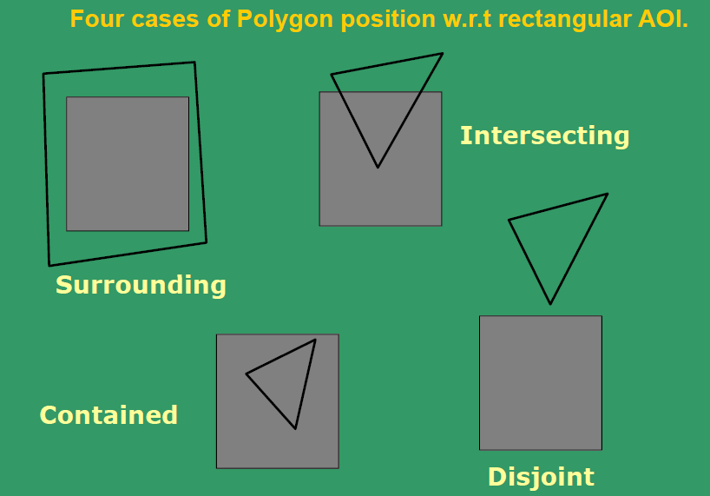
Cont’d
An easy way to do this is to successively divide the area into four equal parts at each step

Slide 50
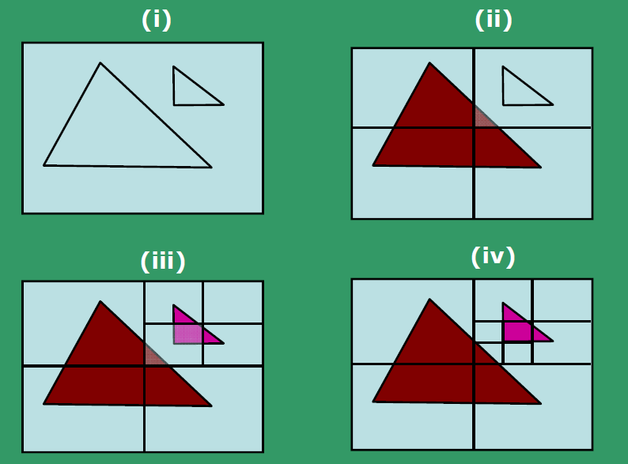
Cont’d
Case Studies – examples of Area Sub-division method

Slide 51
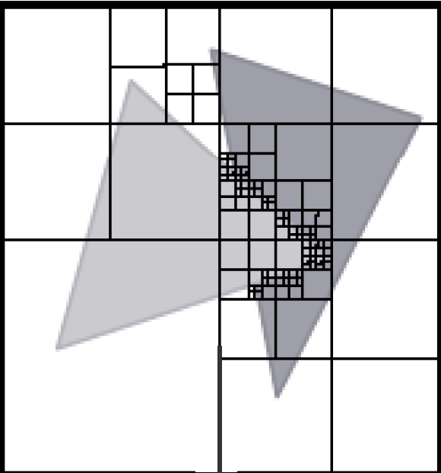
Cont’d

Slide 52
BSP-TREE METHOD
A binary space-partitioning (BSP) tree is an efficient method for determining object visibility by painting surfaces onto the screen from back to front, as in the painter's algorithm.
The BSP tree is particularly useful when the view reference point changes, but the objects in a scene are at fixed positions.

Slide 53
Cont’d
Identify surfaces that are inside/front and outside/back w.r.t. the partitioning plane at each step of the space division, relative to the viewing direction.
Start with any plane and find one set of objects behind and the rest in the front.
In the tree, the objects are represented as terminal nodes with front objects as left branches and back objects as right branches.

Slide 54
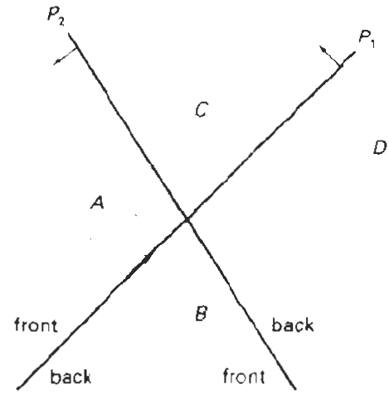
Cont’d
A region of space is
partitioned with two
planes P1, and P2

Slide 55
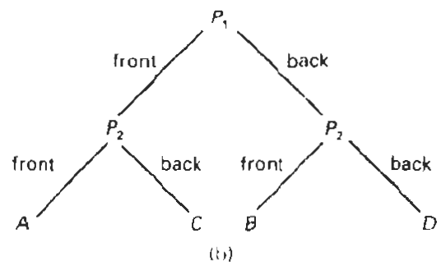
Cont’d
BSP tree representation

Slide 56
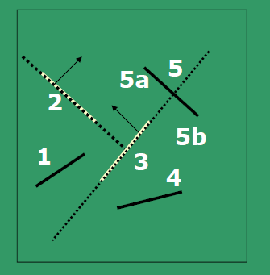
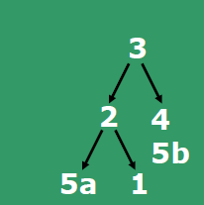
Cont’d
Construct BSP

